Slide 1

Battle for Neighbourhoods
Capstone Project - Final Project

Slide 2
Background
The emergence of location services has created new capabilities and existing businesses are finding new threats every day. Start-ups leveraging new technologies and innovative business models have continued to disrupt and influence how customers choose their travel destinations, activities to engage in, places to stay and eat, and the number of travelers suitable for a specific season. To remain competitive, businesses have embraced use of location data to identify consumer patterns, tastes, and trends. Location data is available from a number of social media platforms including Google maps, Facebook check-in data, location reviews on sites like TripAdvisor and Booking, Foursquare among other location data providers. After learning data science, two friends who have a young start-up travel business decide to change the business model by applying data science skills and techniques. It is their believe that data science will improve their customer experience, grow customer loyalty, promote the company brand and set the company out as a choice travel agent.

Slide 3
Problem
The start-up faces a lot of competition from established businesses and their services are not differentiated from those of their competitors. Their recommendation on travel itinerary to their customers has not yielded the much needed growth in business. The company might close down if this trend continues.

Slide 4
Applying data science to solve the problem
To solve the existing problems, the start-up intends to collect location data from Foursquare and apply data science techniques and tools. The data collected will involve comparison of two locations to determine which is the best location to recommend to a customer. The two locations under consideration are Virginia Beach, VA and Pompano Beach. The customer has requested our business to get him a location with the best coffee shop. We examine these two locations to get the best coffee shops and recommend them to our customers.

Slide 5
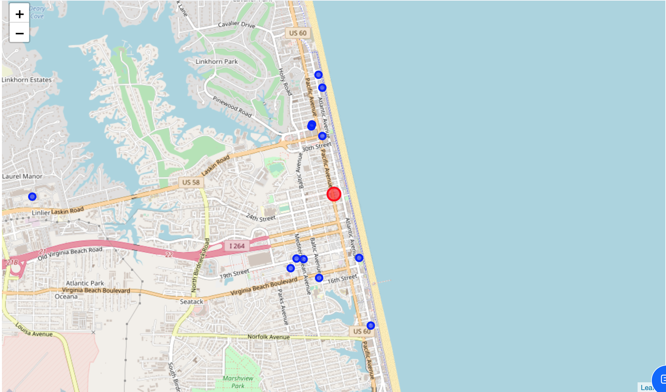
Virginia Beach
We found 14 coffee shops. The nearest was Starbucks, which was 700 meters from the beach. It has a rating of 7.8 and has 32 tips. The coffee shops are located a bit far from each other indicating that the area has lesser concentration of coffee customers.

Slide 6
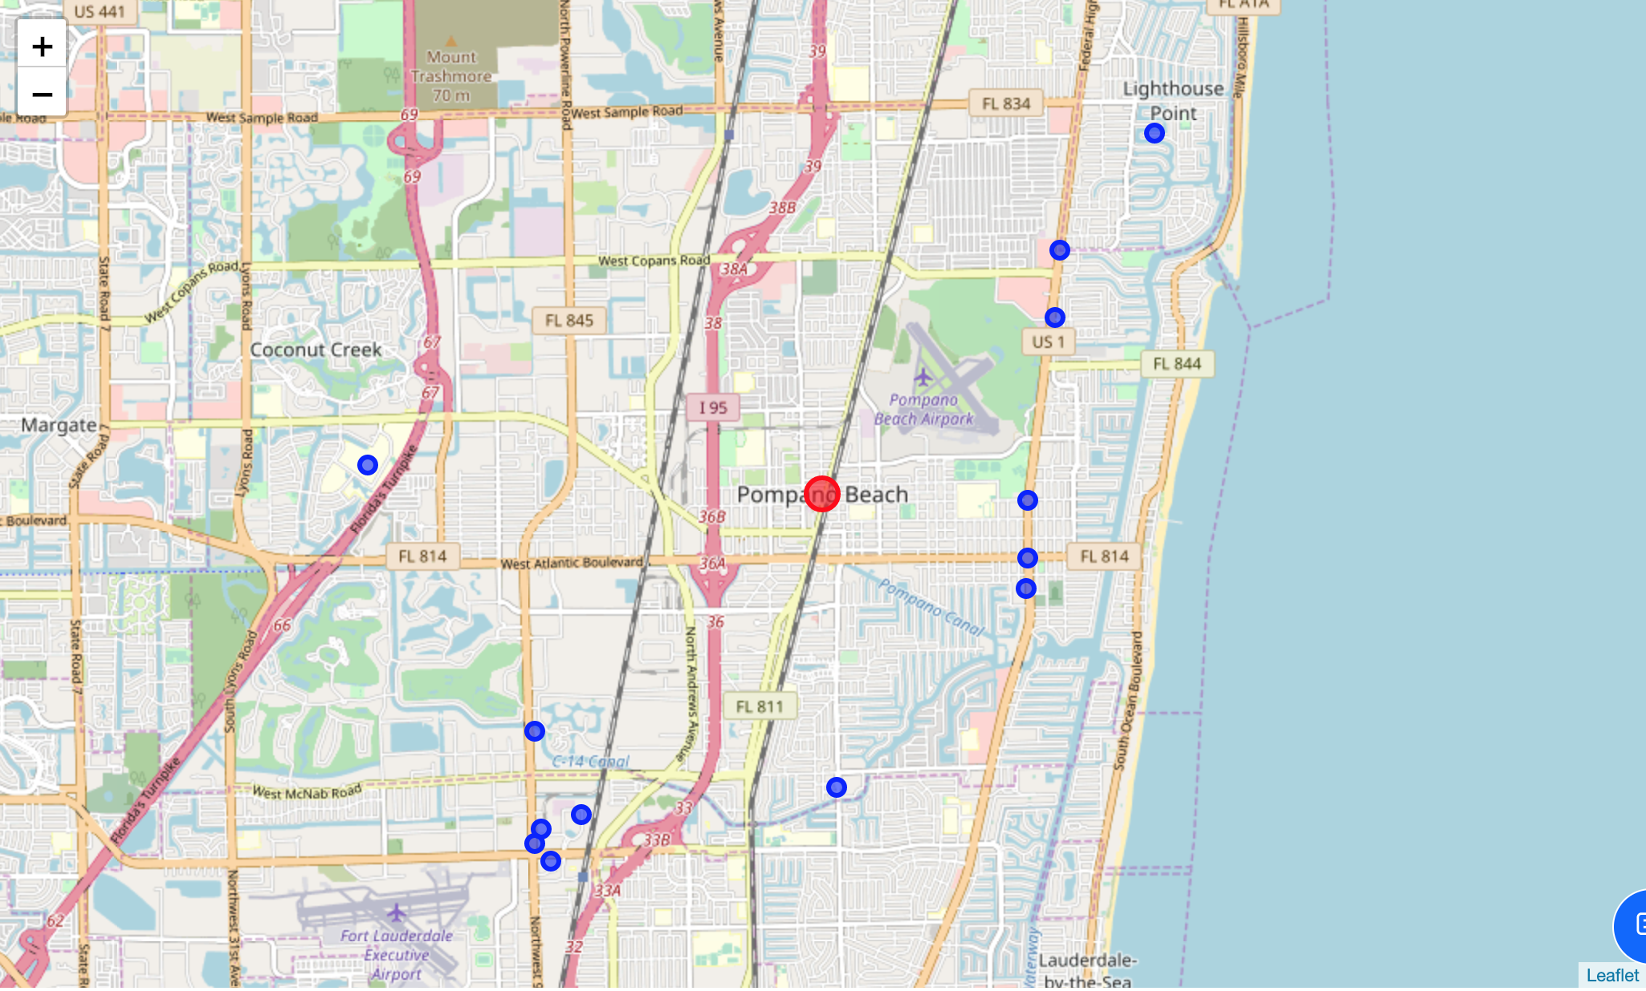
Pompano Beach
We found 17 coffee shop. The nearest Starbucks coffee was a bit far, 2398 meters. It has a rating of 8.3 and 21 tips. The coffee shops are closely located to each other meaning that the area attracts more customers.

Slide 7
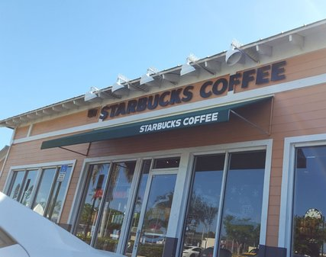
Discussion
Based on the customer requirements for good coffee shops and analysis presented above, we will recommend Pompano Beach to our customer. We hope that the higher concentration of coffee shops in Pompano as well as availability of quality coffee shops like Starbucks will give our customer good selection and variety.

